Slide 1
Toxicology
ED Orientation
June, 2015
Lucy Vermeulen

Slide 2
Definition
“Toxic agents are manufactured or naturally occurring
chemicals that have deleterious effects on humans”
Can enter body through ingestion, inhalation, injection,
skin, mucous membranes
Exposure can be accidental, intentional
Exposure can be related to vocation or recreation
Quantity required to produce symptoms is extremely
variable among substances
Sturt, 2010, p. 564

Slide 3
NENA Core Competencies: Toxicology
Access to poison control information
Knowledge of specific antidote administration
Administration of charcoal
Assist with gastric lavage
Assist with whole bowel irrigation
NENA, 2014

Slide 4
Knowledge of common poisonings and methods to prevent absorption and enhance elimination (e.g. sodium bicarbonate, naloxone,
N-acetylcysteine, flumazenil, specific antidotes)
Recognition of substance intoxication and abuse
Knowledge of protocols and treatment for substance abuse and withdrawal
NENA, 2014

Slide 5
Priorities of Care
ABC
Attempt to ID toxins
Patient safety
Limit absorption
Enhance elimination
Notes:
ABC: may need to intubate
ID toxins: Micromedix; poison control centres
Patient safety: if intentional – still suicidal?
Limit absorption: Prevent further damage as much as possible – i.e eye splash; gastric decontamination if needed;
Binding agents: limit the bioavailability of certain poisons. Activated charcoal; digibind; magnesium hydroxide has been found to be effective in dec. serum iron levels.
Enhance elimination: charcoal, dialysis

Slide 6
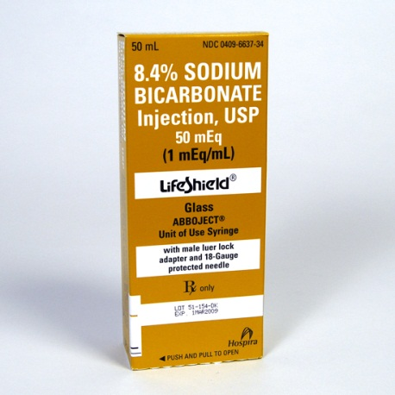
Interventions Specific to Substance
Antidotes
Urinary alkalinization
Notes:
Antidotes
Urinary alkalinization can increase renal elimination of salicylates, phenobarbital by changing them to a less absorbable form. Done with bicarb.

Slide 7
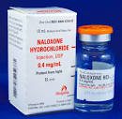
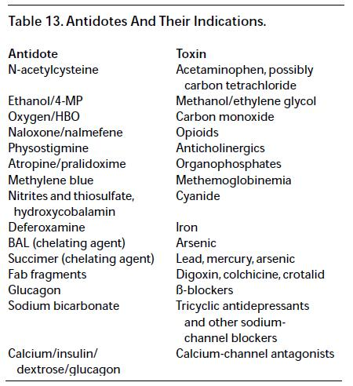
Antidotes
Notes:
Flumazenil – benzo’s

Slide 8
Salicylates
Analgesic, anti-inflammatory, antipyretic properties
Moderate toxicity: dose>250mg/kg; severe: >500
Symptoms: tachypnea, agitation, ataxia,
hypotension, metabolic acidosis, resp. alkalosis
renal failure,
coma, convulsion, cardiac dysrhythmias
Decreased platelets
Notes:
Pepto Bismol
ASA
Oil of wintergreen
BenGay
Saliclylates stimulate the respiratory center of the brainstem, resulting in hyperventilation and resp. alkalosis. BUT they also dec. ATP production which leads to metabolic acidosis.
Children usually present with metabolic acidosis while adults often present with resp. alkalosis.
Dec. platelet production contributes to petechiae.
Treatment: gastric lavage, urinary alkalinization to increase renal excretion (bicarb), hemodialysis, if have seizures: benzos

Slide 9
Treatment
Gastric lavage
Urinary alkalinization

Slide 10
Acetaminophen
Present in analgesics, antipyretics & cold remedies
Toxic dose in children > 6: 10g or 200mg/kg
In adults: 7.5g
Time | Symptoms
0-24 hours | Asymptomatic, N/V, anorexia,
24-48 hours | Inc. LFTs & PTT, RUQ pain, oliguria
72-96 hours | Jaundice, liver failure, Dec sugar, death?
4 days-2 weeks | Slow resolution
Sturt, 2010
Notes:
Often unintentional in pediatrics, but intentional in adults
Toxic doses deplete enzymes that usually detoxify the metabolites, damaging both the liver & kidneys.
Serum levels of 200mcg/mL or higher 4 hours post ingestion are considered toxic.

Slide 11
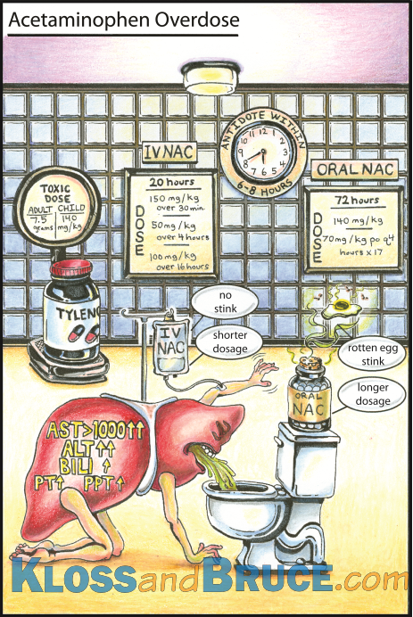

Slide 12

Treatment
N-acetylcysteine (NAC, Mucomyst)
Replenishes liver enzymes allowing for removal of
Acetaminophen metabolites
Best if given within 8-10 hours of ingestion.
Anti-emetics
Activated charcoal

Slide 13
NSAIDS
>100mg/kg associated with GI symptoms (abd pain,
vomiting, diarrhea).
Symptoms with very large ingestion may include:
drowsiness, acidosis, coma, apnea, bradycardia,
renal failure

Slide 14
Treatment
Activated charcoal
Antacids
PPI

Slide 15
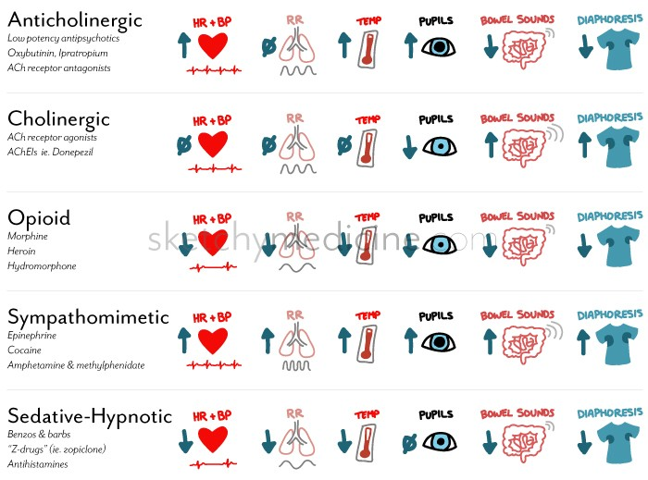

Slide 16
CNS Stimulants
Simulate the sympathetic branch of the autonomic
nervous system
Produce varying degrees of alpha, beta 1 or beta 2
innervation
Can be ingested, injected, inhaled, snorted,
absorbed rectally or vaginally
Notes:
Cocaine, methamphetamines, caffeine, pseudoephedrine, ritalin, diet pills, Red Bull, PCP
Toxic levels are very variable

Slide 17
Symptoms
Degree of Intoxication | Effects
Mild | Insomnia, chatty, restless, agitated, tremor
Moderate | Inc BP, H/A, tachy, hallucinations, chest pain
Severe | Paranoia, shock, seizures, MI, acidosis, coma, Inc. temp rhabomyolysis
Late | Difficult to rouse, prolonged sleeping
Sturt, 2010
Notes:
Other symptoms: cardiac dysrhythmias, delirium, mania, aggression, coronary artery spasms, coagulopathies, pupil dilation

Slide 18
Treatment
ABC
Patient safety
Symptom management
Adequate fluid volume
Gastric lavage
Continuous cardiac monitoring
Temperature monitoring
Sedation
Beta blockers
Notes:
Avoid restraints if at all possible
CNS stimulants affect the sympathetic nervous system – may need beta blocker to blunt effect
IV benzos are treatment of choice for those at risk for seizures

Slide 19

Opiates
All act on CNS producing euphoria, sedation,
analgesia or amnesia.
Act on respiratory center causing respiratory
depression or apnea
Slows GI system
Notes:
Derived from the opium poppy
Available legally
Illegally: often cut with caffeine, amphetamines, PCP sugar

Slide 20
Treatment
ABC
Naloxone: blocks opiate receptor sites
may need to repeat q20-60 minutes
Just want to revers respiratory & neuro effects;
don’t want to fully awake the patient
Activated charcoal
Notes:
Usually give in does of 0.2 mg; may need up to 4 mg of narcan

Slide 21
Effects of Narcotic Use
 | Potential Effects
Narcotic | Pinpoint pupils, dec. resp. rate, altered LOC, dec. BP, hallucinations, sleep, coma
Lifestyle | Skin abscesses, malnutrition, sepsis, endocarditis, cellulitis, dental disease, hepatitis, HIV
Withdrawal | Dilated pupils, rhinorrhea, abd. pain, diarrhea, vomiting, agitation, confusion, fever, joint pain
Sturt, 2010

Slide 22
Benzodiazepines
Produces CNS depression
Symptoms include: slurred speech,
unsteadiness, lethargy, hypothermia,
confusion, coma
Notes:
Potentiate effects of the inhibitory neurotransmitter GABA

Slide 23

Treatment
ABC
Symptom management
Close cardiac & neuro monitoring
Flumazenil
Notes:
Flumazenil blocks benzos at their receptor sites.
Flumazenil can induce seizures in pts. With benzo addictions and in patients who have also OD’d on TCAs
How will you treat if pt was given flumazenil and now has a seizure?
Usuall does is 0.2 mg over 30 seconds; may need to repeat

Slide 24
Alcohol
Toxic alcohols common in many household products
Type of Alcohol | Household Products
Methanol (wood alcohol) | Windshield wiper fluid, paint remover
Isopropanol | Rubbing alcohol, nail polish remover, disinfectants
Ethylene glycol | Antifreeze, detergents, paints, coolants
Sturt
Notes:
Windshield wiper fluid, paint removers
Ingestions can be accidental, recreational, suicidal, or can occur because unable to get ethanol
Can be inhaled or topically absorbed
The toxins can produced widespread damage & metabolic dysfunction.

Slide 25
Symptoms
CNS depression
Respiratory depression
Methanol toxicity: N/V, abd. pain, blindness, coma
Isopropanol toxicity: Dec BP, vomiting,
Ethylene glycol toxicity: seizures, dysrhythmias,
ataxia, coma
Notes:
Methanol: metabolic acidosis
Isopropanol: presence of ketones, hyperglycemia
Ethylene glycol: metabolic acidosis and large osmolar gap

Slide 26
Treatment
ABC
Symptom management
Ethanol infusion
Ensure glucose levels adequate
Notes:
Lungs are responsible for eliminating a large part of toxic alcohols – may need to intubate to maximize this effect
Hemodialysis = to remove toxicity and to reverse acidosis
Ethanol infusion – absorbs and slow methanol and ethylene glycol breakdown and prevents toxic buildup.
Can also use an antidote Fomepizole (Antizol)
Not indicated for isopropanol toxicity
If giving glucose, also give thiamine because thiamine allow brain to metabolize the sugar.

Slide 27
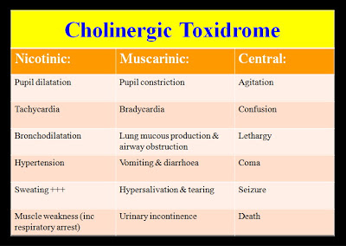
Cholinergic Toxidrome
Notes:
Common culprits: Organophosphate pesticides, Eye drops for glaucoma; Mushrooms (certain types), Sarin (warfare agent)
The underlying mechanism is excessive cholinergic (acetylcholine) receptor stimulation.
There are various classes of cholinergic receptors (see table) that can be stimulated in this toxidrome.
The symptoms induced depend on the relative stimulation of the different receptors.

Slide 28
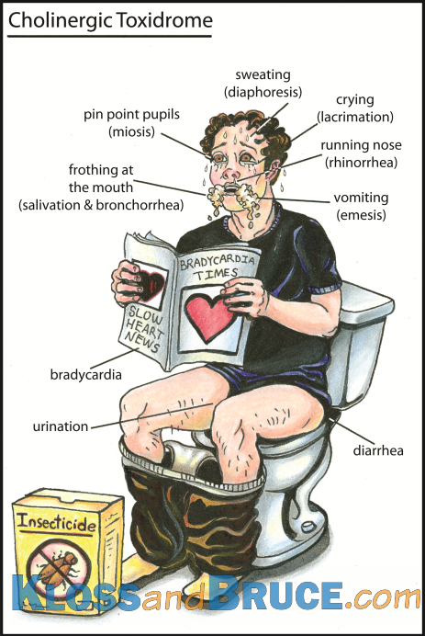
Atropine
Supportive care
Notes:
Treatment includes atropine and supportive care

Slide 29
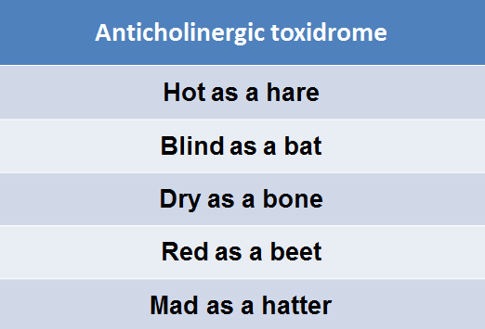
Anticholinergic Toxidrome
Notes:
Common culprits: Gravol, Benedryl Phenothiazines Atropine Baclofen TCA Antidepressants Antipsychotics Jimson Weed
Red as a beet" – Cutaneous vasodilation occurs as a means to dissipate heat by shunting blood to the skin, in order to compensate for the loss of sweat production.
"Dry as a bone" (anhidrosis) – Sweat glands are innervated by muscarinic receptors, so anticholinergic medications produce dry skin.
"Hot as a hare" (anhydrotic hyperthermia) – Interference with normal heat dissipation mechanisms (ie, sweating) frequently leads to hyperthermia.
"Blind as a bat" (nonreactive mydriasis) – Muscarinic input contributes to both pupillary constriction and effective accommodation. Anticholinergic medications generally produce pupillary dilation and ineffective accommodation that frequently manifests as blurry vision.
"Mad as a hatter" (delirium; hallucinations) – Blockade of muscarinic receptors in the central nervous system (CNS) accounts for these findings.
"Full as a flask" – The detrusor muscle of the bladder and the urethral sphincter are both under muscarinic control; anticholinergic substances reduce detrusor contraction (thereby reducing or eliminating the desire to urinate) and prevent normal opening of the urethral sphincter (contributing to urinary retention).

Slide 30
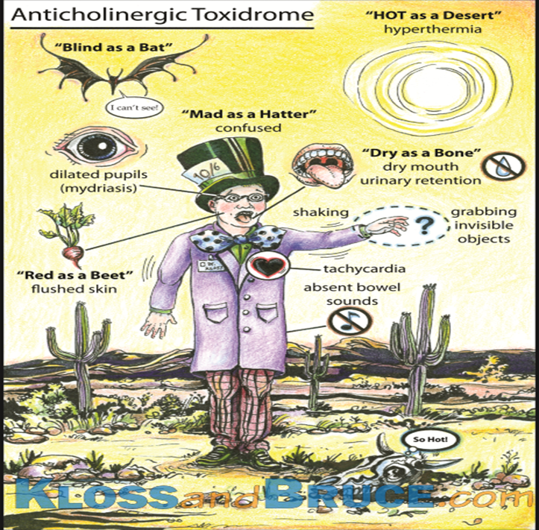
Treatment
Fluids
Safety
Symptom
management
ECG
Physostigmine
Notes:
ECG – some drugs contribute to prolonged QT intervals
physostigmine is indicated when patients manifest both peripheral and moderate central anticholinergic toxicity (moderate to severe agitation/delirium).
Physostigmine should not be given if a condition other than a purely anticholinergic poisoning is suspected (eg, tricyclic antidepressant overdose

Slide 31
Beta blockers, Calcium Channel Blockers & Digoxin
Lethal
Calcium channel blockers stop the movement
of calcium, resulting in decreased perfusion
(calcium is needed for contractility)
Beta blockers decrease cardiac rate & contractility
Notes:
Calcium channel blockers – one of the most lethal prescription drug ingestions; symptoms include dysrhythmias, shock, bradycardia, cardiac collapse
Beta blockers – decrease heart rate, contractility, are used in treatment of hypertension, glaucoma. Propanolol is considered the most toxic beta blocker
Onset: 20min-2hrs
Digoxin: dig blocks the sodium-potassium pump. With high serum concentrations, both vagal and sympathetic tone increases. Symptoms: lethargy, coma, cardiac conduction blocks, Vtach, Vfib, asystole, profound hypotension

Slide 32
Treatment
Cardiac monitoring, ECG
Atropine
Pacing
Dopamine infusion
Glucagon IV
Calcium compound
Notes:
Atropine – can try, but often found to be ineffective in calcium channel blocker toxicity
Pacing
Dopamine 5-10 mcg/kg/min
Glucagon 5-15 mg: Glucagon competes for receptor sites and neutralizes the effects of beta blockers.
Calcium chloride or calcium gluconate
Digibind: attaches to digoxin making it inactive; indicated for life threatening arrhythmias, high serum dig toxicity,

Slide 33

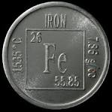
Others
Iron
Hydrocarbons
Toxic plants
Notes:
Iron overdose is one of the most common and severe in kids under 6 yrs.
Iron is widely available in many OTC preparations.
Toxicity: GI mucosal wall damage, perforation, hemorrhage and necrosis;
Also cause cell damage by interfering with aerobic metabolism, causing lactic acidosis
Doses > 40mg/kg are serious
Treatment for iron OD: stabilization, ?gastric lavage, deferoxamine is the specific antidote (infusion at 15mg/kg/hr)
Hydrocarbons: found in petroleum, natural gas, coal, lighter fluid, kerosene.
Accidental exposures are common in kids< 5; adults are exposed because of occupation
Toxicity: pulmonary aspiration or systemic absorption
Neuro symptoms includes: confusion, HA, ataxia, coma
Hydrocarbons affect cardiac conduction system causing blockade, asystole and Vfib
Also causes kidney & liver failure
Treatment: symptomatic management
Toxic plants: tropical plants and in the environment. There are more than 100 species of toxic mushrooms alone.
Some plants contain hallucinogenic, narcotic, anticholineric toxins causing people to abuse
Some have neuro, cardiac, GI effects
Common culprits: poinsettia, diffenbachia, lily of the valley, jimsonweed

Slide 34
Illicit Drug Use
Health care professionals generally have negative
view of patients with history of current or past illicit
drug use
This negative perspective is an important predictor
in terms of patient outcome (seeking treatment or not;
LAMA; suboptimal nursing care)
Chu & Galang, 2013
Notes:
Illegal drugs accounted for approximately $8.2 billion (20.7%) of the nearly $40 billion cost of substance abuse in Canada in 2002. In the same year, 1,695 deaths, 554,131 criminal offences and 133,120 criminal charges were attributable to illegal drugs (Canadian Centre on Substance Abuse)
Prevalence of cocaine & heroin injection has declined but prescription opiate injection has increased significantly along with smoking crack, meth use
Ensure staff safety – dirty needles
Patients are allowed to make bad decisions

Slide 35
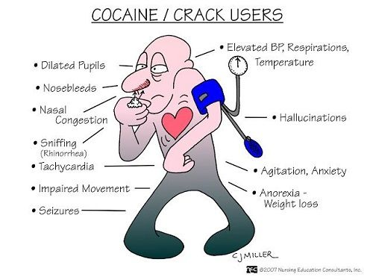
Illicit Drugs
Cocaine, crack
Methamphetamine
Heroin
Prescription narcotics: tablets, patches, time release
Marijuana
Ecstasy (MDMA)
Notes:
Crack, cocaine: stimulant, vasoconstrictor, inc HR, temp, BP, dilated pupils, erratic behaviour, paranoia. Cocaine use is associated with a large abrupt and transient increase in the risk of acute myocardial infarction
in patients who are otherwise at relatively low risk. Treatment for MI: similar to ACS but with benzos and without betablockers (betablockers inc. risk of vasospasm) [Mukherjee, 2015]
Methamphetamine: stimulant, produces wakefulness, euphoria (key ingredient is pseuoephedrine common to OTC cold remedies); causes release of dopamine. About 1.4 million users in US (admitting to using)
vasoconstrictor
increased wakefulness, decreased appetite, general sense of well-being ,increased heart rate and respiration, increased body temperature
MA users may also experience: tremors; insomnia, mental confusion, irritability and aggression, hyperthermia, which can cause convulsions, chest pain, hypertension,
cardiovascular collapse
Heroin: fast-acting opiate; resp depression, dec. LOC, itching, nausea & vomiting
Prescription narcotics: incidence increasing; resp depression; highly addictive
Marijuana: distorted perceptions, impaired coordination, difficulty in thinking and problem solving, ongoing problems with learning and memory, red, blurry, bloodshot eyes
constant, mucus-filled cough; rapid heartbeat; hunger; dry mouth; anxiety, paranoia, or fear;
poor memory; poor coordination; slow reaction time; loss of control
Ecstasy: incidence is fairly low; symptoms include
Short-term: Muscle aches; nausea and vomiting; teeth grinding; increased energy; hyperactivity; increased heart rate; increased temperature and sweating; depression; sleeplessness.6
Long-term: Sleeping problems; high blood pressure; liver problems; panic attacks; jaundice; memory deficits; attention deficits

Slide 36
IVDU
IVDUs associated with difficult vascular access
Risk for hepatitis, HIV: 1 in 4 admits to sharing needles
Frequently associated with sepsis, cellulitis,
endocarditis
Require close monitoring, judgment-free approach
acknowledgement that patient has right to refuse
care
Notes:
Injection of particulate matter (such as talc) along with illicit drugs may cause endothelial damage to the tricuspid valve
S. aureus is the most common cause of infective endocarditis
In the general population, right-sided endocarditis is less common than left-sided endocarditis. Most cases of right-sided infective endocarditis occur among injection drug users
Stat from LFP 2013 http://www.lfpress.com/2013/11/20/a-survey-uncovers-grim-numbers-in-london

Slide 37
Harm- Reduction Strategies
Methadone
Suboxone
Needle exchange programs
Judgment-free approach
Notes:
Suboxone: oral tab containing narcan – which only gets activated if injected

Slide 38
Symptoms & management
Withdrawal

Slide 39
Alcohol Withdrawal
Must be voluntary, unless unstable
Associated with DTs 24-72hours after last ingestion
Symptoms: seizures, tachycardia, tachypnea,
hyperpyrexia, delusions, disorientation, hallucinations,
confusion, impaired attention, increased motor activity
Benzos

Slide 40
Treatment
Judgment-free approach
Outpatient options
Inpatient: monitor vital signs, nutrition,
fluid balance, safety, medications

Slide 41
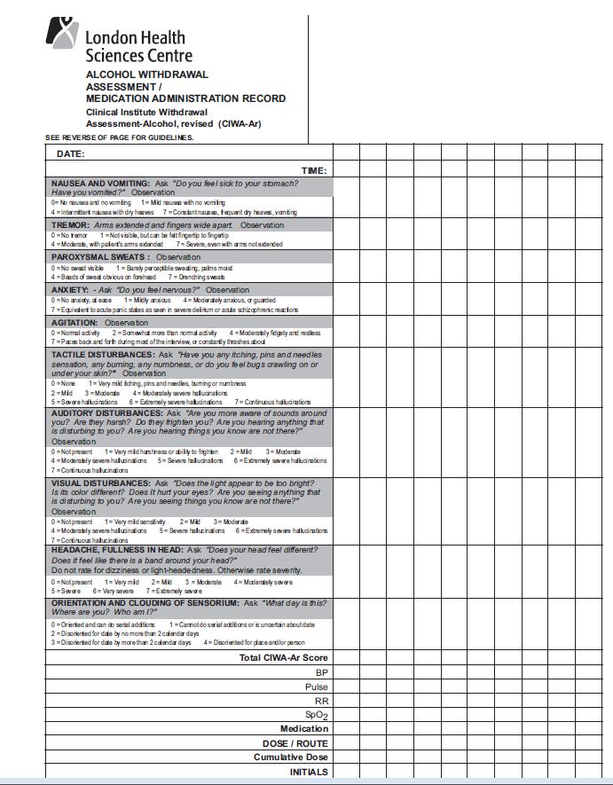
CIWA Screening Tool
Evaluate patient
Based on 7 criteria
Notes:
Criteria: nausea/vomiting; tremor; paroxysmal sweats; anxiety; agitation; tactile disturbances; auditory disturbances; visual disturbances; headache/fullness in head; orientation and clouding of sensorium

Slide 42
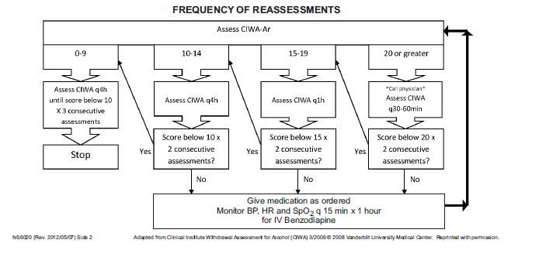
Patient’s score determines frequency of vital signs
& medication administration

Slide 43
Nursing Care
History is key: when, what, amount, why, how
Learn medication effects (symptoms, duration, effects)
Monitor patient closely
Intentional vs accidental
Judgment free
Offer available resources if treatment desired
Aggressive treatment & close monitoring for IVDUs

Slide 44
Case Scenarios
44 year old woman presents with decreased LOC –
Found in public place by by-stander. Hx unknown.
Vital signs: HR 88 RR 22 BP 106/78 SpO2 94%RA,
She is restless & diaphoretic
Notes:
priorities: ABC
FP found to be 2.1

Slide 45
Case Scenario
36 year old male presents to the ED
unconscious, vomited en route with EMS.
HR 65, RR 8 BP 96/65 afebrile, SpO2 90%
Notes:
History unknown
Pupils pinpoint
Priorities: ABC – not protecting airway, oral airway inserted, 1:1 nursing
Needs Narcan
Admits to chewing Fentanyl – discuss time-release with meds

Slide 46
Case Scenarios
A 76 year old woman presents with lightheadedness,
Had syncopal event this morning – now oriented x 3
HR 48, BP 112/76, RR 18, afebrile, SpO2 94%
RA. Past medical history a fib, Type 2 DM, chronic back
Pain, fibromyalgia
Medications: Metformin, Digoxin, Tylenol prn, Gabapentin
Notes:
Priorities: ABC – Monitor shows slow a fib
Accidentally OD of digoxin

Slide 47
Case Scenario
22 year old presents with fever, lethargy for 2 days.
T 38.9 HR 140 RR 26 BP 96/68 SpO2 94% RA
Has roommate who give vague history. Patient
smells of body odour
Notes:
Get patient undressed
ABC, Fluids, abx urgently
Note track marks on arms
Notice cellulitis on Left inner upper thigh
Several hours later patient more alert and wants to leave for a smoke

Slide 48
Case Scenario
A 22 year old woman presents behaving erratically,
laughing inappropriately, restless, chatty.
Bartender called EMS
HR 128, RR 20 Afebrile, BP 104/72, SpO2 95%RA
Notes:
Priorities: ABC; get patient undressed
Note patient is now sleeping: what do you do?
Then patient vomits
Supportive care; don’t know what she took – bunch of pills

Slide 49
References
Chu, C. & Galang, A. (2013). Hospital Nurses’ Attitudes toward Patients with a history
of Illicit drug use. Canadian Nurse, June 2013. Retrieved April 20, 2015 from
http://www.canadian-nurse.com/en/articles/issues/2013/june-2013/hospital-nurses-attitudes-
toward-patients-with-a-history-of-illicit-drug-use
National Emergency Nurses Association (2014). Emergency Nursing Core
Competencies. Retrieved April 17, 2015 from
http://nena.ca/w/wp-content/uploads/2014/11/NENA-Core-Competencies.pdf
Sturt, P. (2010). Toxicological Emergencies. Sheehy’s Emergency Nursing Principles and
Practice, 6th ed. St Louis, Missouri: Mosby Elsevier

